Slide 1
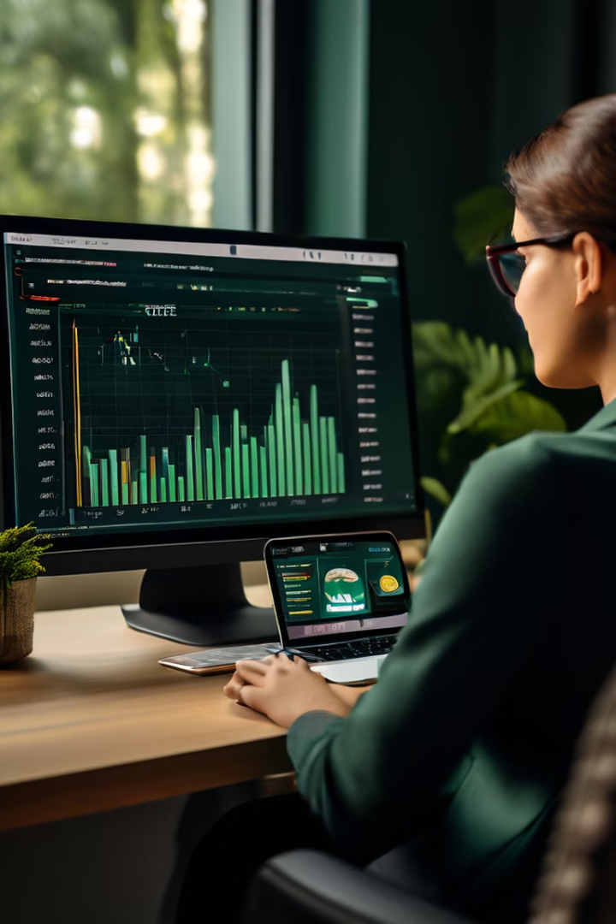
Finertia – We Ensure Stability
Finertia empowers users to take control of their financial future by providing a comprehensive platform for managing their finances, understanding their spending habits, and building a solid financial foundation.
By Group 20

Slide 2

Purpose
Transaction Tracking
Personalized Insights
Our platform allows users to effortlessly track their income and expenses, providing a clear and detailed picture of their financial activities.
we generate personalized insights and recommendations based on user spending patterns, helping them understand their financial behavior.
Budgeting Recommendations
Financial Education
Users receive tailored budgeting recommendations, ensuring their spending aligns with their financial goals and promoting responsible financial management.
We offer educational resources and tools to empower users with the knowledge and skills needed to make informed financial decisions.

Slide 3

Key Functionalities
1
User Authentication
Securely verify user identities, ensuring the safety and integrity of their financial information.
2
Profile Management
Allow users to create and manage their profiles, personalize their experience, and access relevant features.
3
Initial UI Designs
Develop a user-friendly and intuitive interface, providing seamless navigation and effortless access to key functionalities.

Slide 4
Dataset Collection
Transaction Data
Financial Indicators
User Behavior Data
We gather comprehensive transaction data from various sources, including bank accounts, credit cards, and investment accounts.
We collect relevant financial indicators, such as interest rates, market trends, and economic data, to provide contextual insights.
We analyze user spending patterns, financial goals, and risk tolerance to personalize our insights and recommendations.

Slide 5

Model Training
1
Machine Learning Models
We train advanced machine learning models to analyze financial data, detect patterns, and generate accurate predictions.
2
Model Optimization
We continually optimize our models to improve their accuracy and performance, ensuring the most relevant insights and recommendations.
3
Data Security and Privacy
We prioritize data security and privacy, implementing robust measures to protect user information and ensure compliance with regulations.

Slide 6




Backend Integration
API Integration
We integrate with various financial institutions and platforms via APIs, providing seamless data access and real-time updates.
Data Synchronization
We ensure data synchronization between different platforms, maintaining consistency and accuracy in user financial data.
Security Measures
We implement robust security measures to protect user data from unauthorized access and ensure the integrity of our systems.

Slide 7
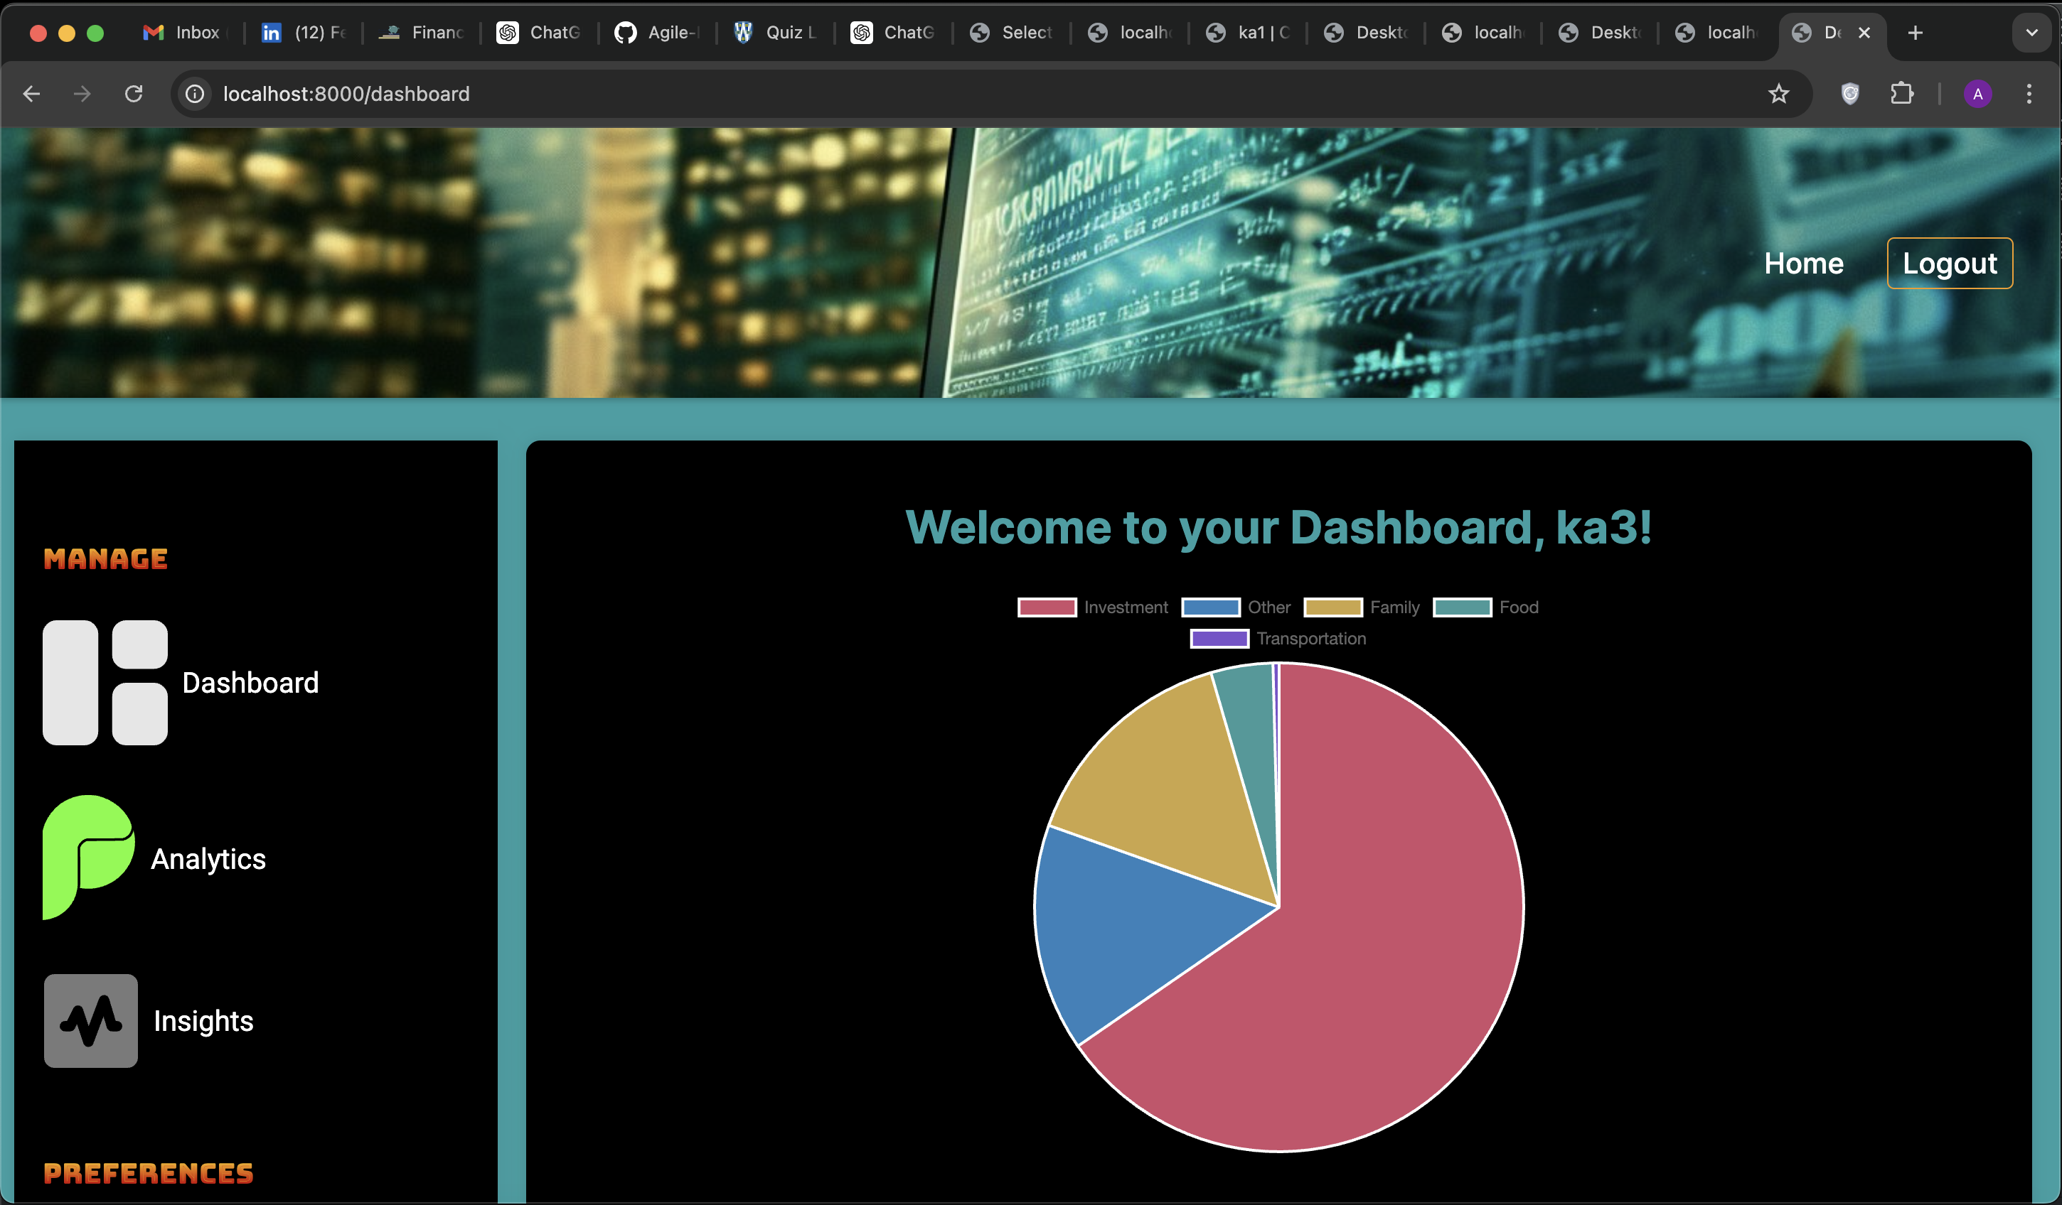
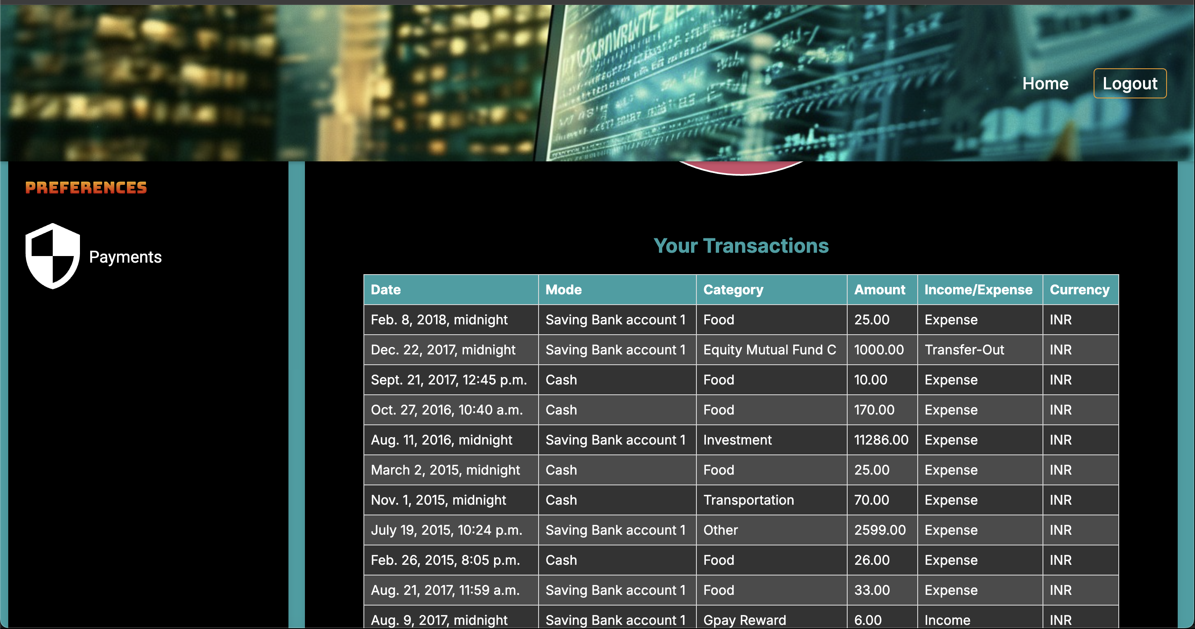
Initial UI Designs
Dashboard Overview
Expense Tracking
A user-friendly dashboard provides a clear overview of key financial metrics, enabling users to quickly assess their financial status.
Users can track and categorize their expenses, gaining valuable insights into their spending habits and identifying areas for improvement.

Slide 8
DEMO

Slide 9
Thank You!

